Slide 1
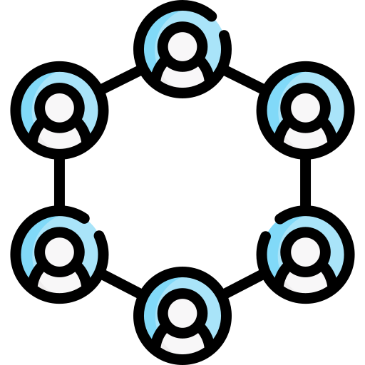
Front-End Automation
DEVP-600-001 Business Innovation with Development Operations (DevOps)
Hai Nam Nguyen
Xuan Hieu Nguyen
Cong Chi Tai Nguyen

Slide 2
Agenda
Problem
Implementation Stages
Architecture
Front-end
Demo
Future Works
Conclusion

Slide 3
Problem Definition
Version control
Deployment environment
Build and Deployment Process
Notes:
accidentally overwrite each other's changes, leading to conflicts and loss of work, hard to revert
difficult to track the history of changes and hard to understand why changes
deploying code across different environments (development, testing, production) can lead to inconsistencies and errors
Manual configuration of deployment environments increases the risk of misconfigurations and dependencies issues -> leading to bugs that are difficult to reproduce and debug
Without automation, deploying updates to production may involve a lot of manual steps, increasing human error

Slide 4
Implementation Stages
Setting Up Version Control with AWS CodeCommit
Building and Testing with AWS CodeBuild
Deployment Automation with AWS CodeDeploy
Configuring AWS S3 Bucket
Notes:
AWS Personal Account not Learner Lab

Slide 5
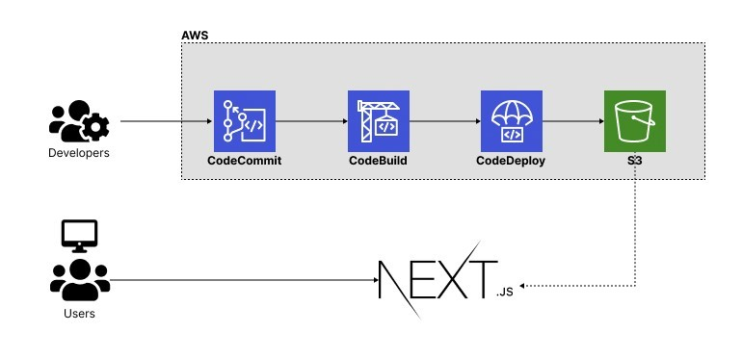
Architecture

Slide 6
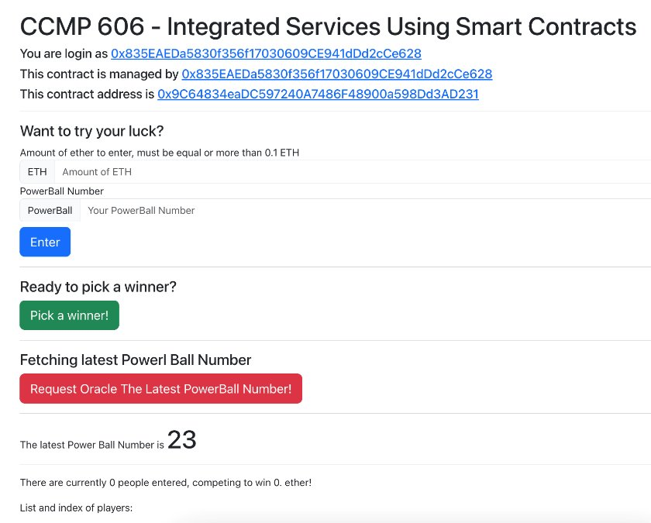
Front-end

Slide 7
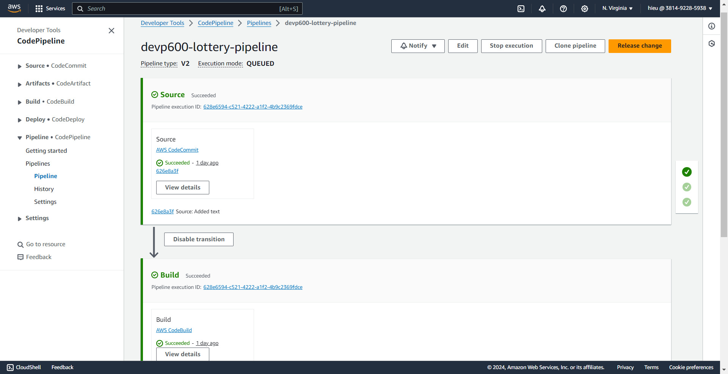
Demo

Slide 8
Future Works
Performance Autotest by using AWS FIS (Fault Injection Service) => Stress test
Apply ELK Stack for evaluation and visualization for application and infrastructure monitoring.

Slide 9
Conclusion
Reducing human mistakes, inconsistencies, and unexpected failures.
Assuring consistency and reliability in deployment environments.
Enabling collaboration among team members.
Offering speed, efficiency, and high-quality delivery by automating tasks.

Slide 10
THANK YOU FOR YOUR TIME
Q&A

